Slide 1
EAS509: Part 2. Time Series Analysis and Forecasting
Ch2. Time series graphics

Slide 2
Outline
Time series in R
Examples
Time plots
Seasonal and subseries plots
Lag plots and autocorrelation
White noise

Slide 3
Time series in R

Slide 4
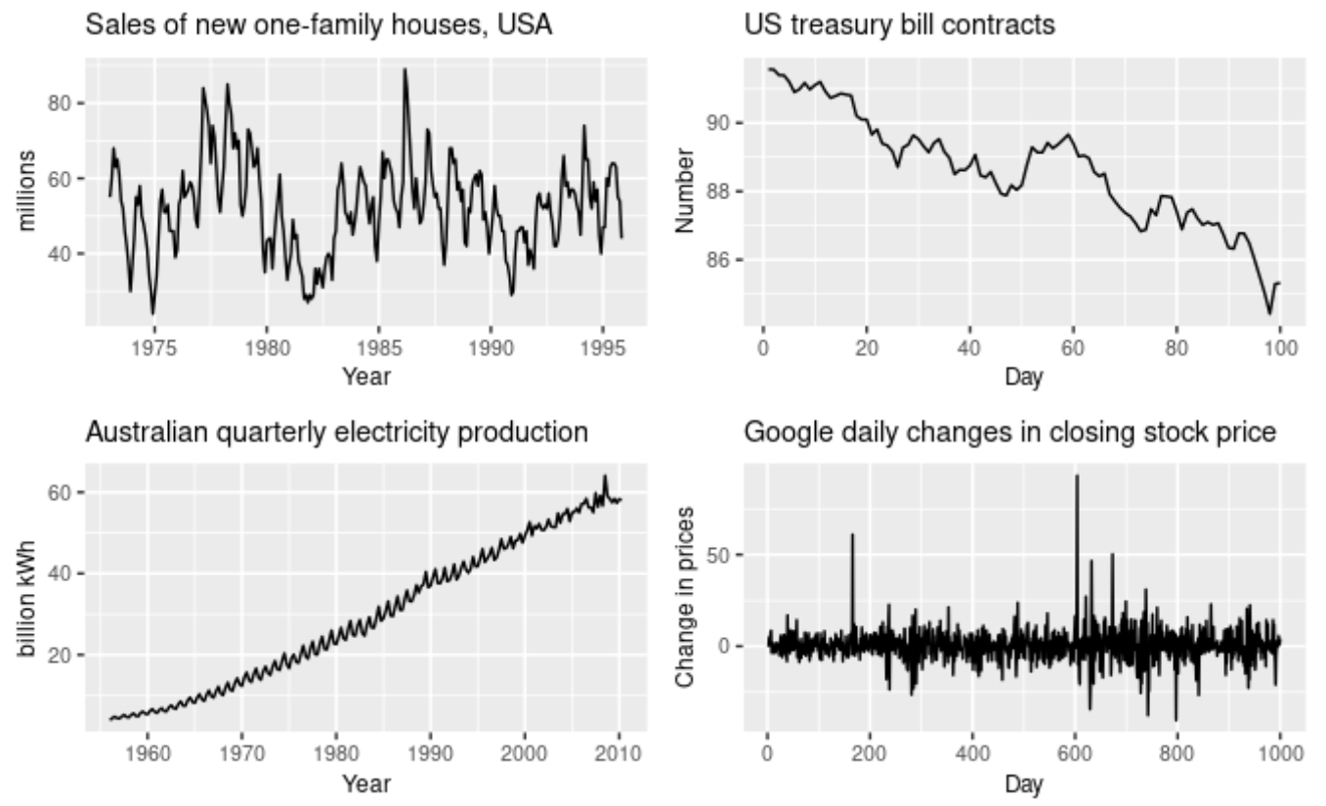
Time Series Data
“A time series is a series of data points indexed (or listed or graphed) in time order.” (Wiki)
Time series Categories:
By time spacing
Regular Time Series
Record every hour, day, week, and so on
Irregular Time Series
Spacing between records is not equal
By Number of Variables
Univariate Time Series
Multivariate Time Series
4

Slide 5
tsibble objects
tsibble - time-series tibble
A tsibble allows storage and manipulation of multiple time series in R.
It contains:
An index: time information about the observation
Measured variable(s): numbers of interest
Key variable(s): optional unique identifiers for each series
It works with tidyverse functions.
tsibble replaces ts object
tibble is newer replacement of Data.Frame

Slide 6
tsibble objects
global_economy
## # A tsibble: 15,150 x 6 [1Y] ## # Key: Country [263] ## Year Country GDP Imports Exports Population ## <dbl> <fct> <dbl> <dbl> <dbl> <dbl> ## 1 1960 Afghanistan 537777811. 7.02 4.13 8996351 ## 2 1961 Afghanistan 548888896. 8.10 4.45 9166764 ## 3 1962 Afghanistan 546666678. 9.35 4.88 9345868 ## 4 1963 Afghanistan 751111191. 16.9 9.17 9533954 ## 5 1964 Afghanistan 800000044. 18.1 8.89 9731361 ## 6 1965 Afghanistan 1006666638. 21.4 11.3 9938414 ## 7 1966 Afghanistan 1399999967. 18.6 8.57 10152331 ## 8 1967 Afghanistan 1673333418. 14.2 6.77 10372630 ## 9 1968 Afghanistan 1373333367. 15.2 8.90 10604346 ## 10 1969 Afghanistan 1408888922. 15.0 10.1 10854428 ## # … with 15,140 more rows
Index
Keys
Measures

Slide 7
tsibble objects
tourism
## # A tsibble: 24,320 x 5 [1Q] ## # Key: Region, State, Purpose [304] ## Quarter Region State Purpose Trips ## <qtr> <chr> <chr> <chr> <dbl> ## 1 1998 Q1 Adelaide SA Business 135. ## 2 1998 Q2 Adelaide SA Business 110. ## 3 1998 Q3 Adelaide SA Business 166. ## 4 1998 Q4 Adelaide SA Business 127. ## 5 1999 Q1 Adelaide SA Business 137. ## 6 1999 Q2 Adelaide SA Business 200. ## 7 1999 Q3 Adelaide SA Business 169. ## 8 1999 Q4 Adelaide SA Business 134. ## 9 2000 Q1 Adelaide SA Business 154. ## 10 2000 Q2 Adelaide SA Business 169. ## # … with 24,310 more rows
Index
Keys
Measures
Domestic visitor nights in thousands by state/region and purpose.

Slide 8
The tsibble index
Example
mydata <- tsibble( year = 2012:2016, y = c(123, 39, 78, 52, 110), index = year ) mydata
## # A tsibble: 5 x 2 [1Y] ## year y ## <int> <dbl> ## 1 2012 123 ## 2 2013 39 ## 3 2014 78 ## 4 2015 52 ## 5 2016 110

Slide 9
The tsibble index: Convertion from Tibble
Example
mydata <- tibble( year = 2012:2016, y = c(123, 39, 78, 52, 110) ) %>% as_tsibble(index = year) mydata
## # A tsibble: 5 x 2 [1Y] ## year y ## <int> <dbl> ## 1 2012 123 ## 2 2013 39 ## 3 2014 78 ## 4 2015 52 ## 5 2016 110
tibble is newer replacement of Data.Frame

Slide 10
The tsibble index: Convertion from Tibble
For observations more frequent than once per year, we need to use a time class function on the index.
z
## # A tibble: 5 × 2 ## Month Observation ## <chr> <dbl> ## 1 2019 Jan 50 ## 2 2019 Feb 23 ## 3 2019 Mar 34 ## 4 2019 Apr 30 ## 5 2019 May 25
z %>% mutate(Month = yearmonth(Month)) %>% as_tsibble(index = Month)
## # A tsibble: 5 x 2 [1M] ## Month Observation ## <mth> <dbl> ## 1 2019 Jan 50 ## 2 2019 Feb 23 ## 3 2019 Mar 34 ## 4 2019 Apr 30 ## 5 2019 May 25

Slide 11
The tsibble index
Common time index variables can be created with these functions:
Frequency | Function
Annual | start:end
Quarterly | yearquarter()
Monthly | yearmonth()
Weekly | yearweek()
Daily | as_date(), ymd()
Sub-daily | as_datetime()

Slide 12
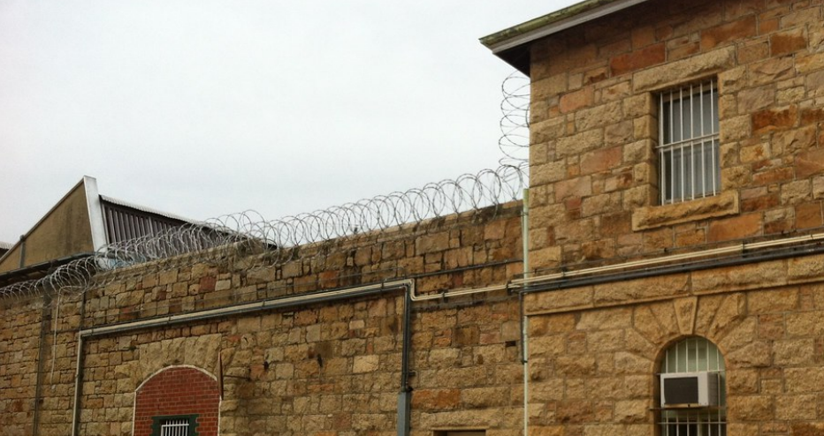
Example: Australian prison population

Slide 13
Read a csv file and convert to a tsibble
prison <- readr::read_csv("data/prison_population.csv")
## # A tibble: 3,072 × 6 ## date state gender legal indigenous count ## <date> <chr> <chr> <chr> <chr> <dbl> ## 1 2005-03-01 ACT Female Remanded ATSI 0 ## 2 2005-03-01 ACT Female Remanded Other 2 ## 3 2005-03-01 ACT Female Sentenced ATSI 0 ## 4 2005-03-01 ACT Female Sentenced Other 0 ## 5 2005-03-01 ACT Male Remanded ATSI 7 ## 6 2005-03-01 ACT Male Remanded Other 58 ## 7 2005-03-01 ACT Male Sentenced ATSI 0 ## 8 2005-03-01 ACT Male Sentenced Other 0 ## 9 2005-03-01 NSW Female Remanded ATSI 51 ## 10 2005-03-01 NSW Female Remanded Other 131 ## # … with 3,062 more rows

Slide 14
Read a csv file and convert to a tsibble
prison <- readr::read_csv("data/prison_population.csv") %>% mutate(Quarter = yearquarter(date))
## # A tibble: 3,072 × 7 ## date state gender legal indigenous count Quarter ## <date> <chr> <chr> <chr> <chr> <dbl> <qtr> ## 1 2005-03-01 ACT Female Remanded ATSI 0 2005 Q1 ## 2 2005-03-01 ACT Female Remanded Other 2 2005 Q1 ## 3 2005-03-01 ACT Female Sentenced ATSI 0 2005 Q1 ## 4 2005-03-01 ACT Female Sentenced Other 0 2005 Q1 ## 5 2005-03-01 ACT Male Remanded ATSI 7 2005 Q1 ## 6 2005-03-01 ACT Male Remanded Other 58 2005 Q1 ## 7 2005-03-01 ACT Male Sentenced ATSI 0 2005 Q1 ## 8 2005-03-01 ACT Male Sentenced Other 0 2005 Q1 ## 9 2005-03-01 NSW Female Remanded ATSI 51 2005 Q1 ## 10 2005-03-01 NSW Female Remanded Other 131 2005 Q1 ## # … with 3,062 more rows

Slide 15
Read a csv file and convert to a tsibble
prison <- readr::read_csv("data/prison_population.csv") %>% mutate(Quarter = yearquarter(date)) %>% select(-date)
## # A tibble: 3,072 × 6 ## state gender legal indigenous count Quarter ## <chr> <chr> <chr> <chr> <dbl> <qtr> ## 1 ACT Female Remanded ATSI 0 2005 Q1 ## 2 ACT Female Remanded Other 2 2005 Q1 ## 3 ACT Female Sentenced ATSI 0 2005 Q1 ## 4 ACT Female Sentenced Other 0 2005 Q1 ## 5 ACT Male Remanded ATSI 7 2005 Q1 ## 6 ACT Male Remanded Other 58 2005 Q1 ## 7 ACT Male Sentenced ATSI 0 2005 Q1 ## 8 ACT Male Sentenced Other 0 2005 Q1 ## 9 NSW Female Remanded ATSI 51 2005 Q1 ## 10 NSW Female Remanded Other 131 2005 Q1 ## # … with 3,062 more rows

Slide 16
Read a csv file and convert to a tsibble
prison <- readr::read_csv("data/prison_population.csv") %>% mutate(Quarter = yearquarter(date)) %>% select(-date) %>% as_tsibble( index = Quarter, key = c(state, gender, legal, indigenous) )
## # A tsibble: 3,072 x 6 [1Q] ## # Key: state, gender, legal, indigenous [64] ## state gender legal indigenous count Quarter ## <chr> <chr> <chr> <chr> <dbl> <qtr> ## 1 ACT Female Remanded ATSI 0 2005 Q1 ## 2 ACT Female Remanded ATSI 1 2005 Q2 ## 3 ACT Female Remanded ATSI 0 2005 Q3 ## 4 ACT Female Remanded ATSI 0 2005 Q4 ## 5 ACT Female Remanded ATSI 1 2006 Q1 ## 6 ACT Female Remanded ATSI 1 2006 Q2 ## 7 ACT Female Remanded ATSI 1 2006 Q3 ## 8 ACT Female Remanded ATSI 0 2006 Q4 ## 9 ACT Female Remanded ATSI 0 2007 Q1 ## 10 ACT Female Remanded ATSI 1 2007 Q2 ## # … with 3,062 more rows

Slide 17

Example: Australian pharmaceutical sales

Slide 18
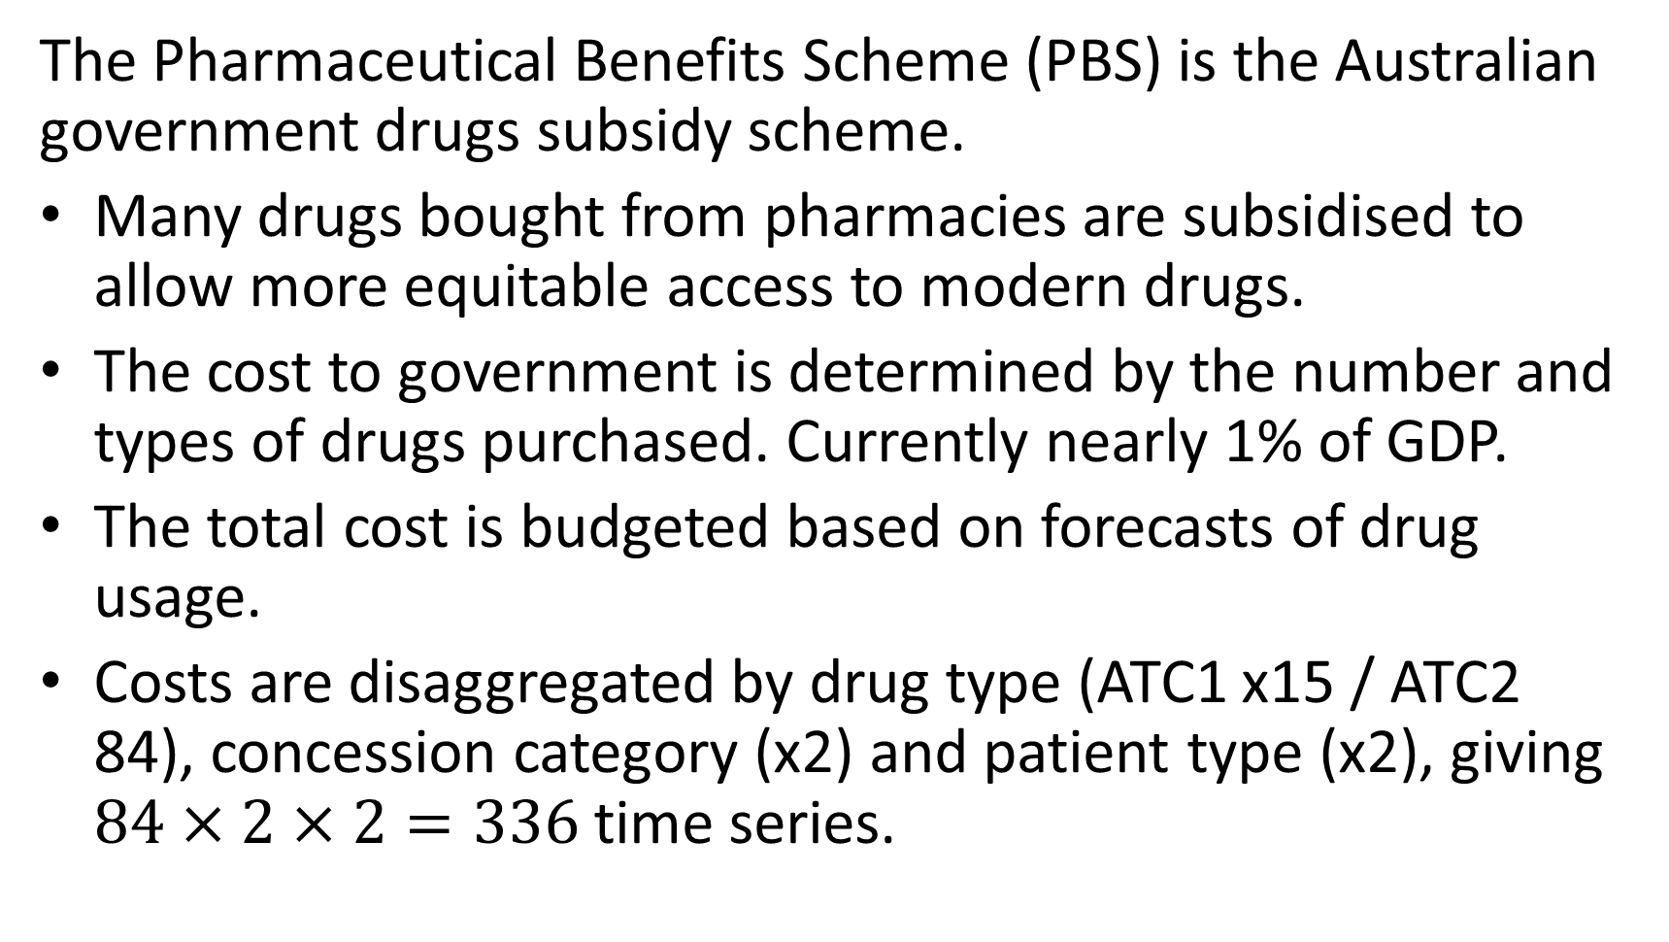
Australian Pharmaceutical Benefits Scheme
The Pharmaceutical Benefits Scheme (PBS) is the Australian government drugs subsidy scheme.
Many drugs bought from pharmacies are subsidised to allow more equitable access to modern drugs.
The cost to government is determined by the number and types of drugs purchased. Currently nearly 1% of GDP.
The total cost is budgeted based on forecasts of drug usage.
Costs are disaggregated by drug type (ATC1 x15 / ATC2 84), concession category (x2) and patient type (x2), giving $84×2×2=336$ time series.

Slide 19
Working with tsibble objects
PBS
## # A tsibble: 67,596 x 9 [1M] ## # Key: Concession, Type, ATC1, ATC2 [336] ## Month Concession Type ATC1 ATC1_…¹ ATC2 ATC2_…² Scripts Cost ## <mth> <chr> <chr> <chr> <chr> <chr> <chr> <dbl> <dbl> ## 1 1991 Jul Concessional Co-payments A Alimen… A01 STOMAT… 18228 67877 ## 2 1991 Aug Concessional Co-payments A Alimen… A01 STOMAT… 15327 57011 ## 3 1991 Sep Concessional Co-payments A Alimen… A01 STOMAT… 14775 55020 ## 4 1991 Oct Concessional Co-payments A Alimen… A01 STOMAT… 15380 57222 ## 5 1991 Nov Concessional Co-payments A Alimen… A01 STOMAT… 14371 52120 ## 6 1991 Dec Concessional Co-payments A Alimen… A01 STOMAT… 15028 54299 ## 7 1992 Jan Concessional Co-payments A Alimen… A01 STOMAT… 11040 39753 ## 8 1992 Feb Concessional Co-payments A Alimen… A01 STOMAT… 15165 54405 ## 9 1992 Mar Concessional Co-payments A Alimen… A01 STOMAT… 16898 61108 ## 10 1992 Apr Concessional Co-payments A Alimen… A01 STOMAT… 18141 65356 ## # … with 67,586 more rows, and abbreviated variable names ¹​ATC1_desc, ## # ²​ATC2_desc

Slide 20
Working with tsibble objects
We can use the filter() function to select rows.
PBS %>% filter(ATC2 == "A10")
## # A tsibble: 816 x 9 [1M] ## # Key: Concession, Type, ATC1, ATC2 [4] ## Month Concession Type ATC1 ATC1_…¹ ATC2 ATC2_…² Scripts Cost ## <mth> <chr> <chr> <chr> <chr> <chr> <chr> <dbl> <dbl> ## 1 1991 Jul Concessional Co-paymen… A Alimen… A10 ANTIDI… 89733 2.09e6 ## 2 1991 Aug Concessional Co-paymen… A Alimen… A10 ANTIDI… 77101 1.80e6 ## 3 1991 Sep Concessional Co-paymen… A Alimen… A10 ANTIDI… 76255 1.78e6 ## 4 1991 Oct Concessional Co-paymen… A Alimen… A10 ANTIDI… 78681 1.85e6 ## 5 1991 Nov Concessional Co-paymen… A Alimen… A10 ANTIDI… 70554 1.69e6 ## 6 1991 Dec Concessional Co-paymen… A Alimen… A10 ANTIDI… 75814 1.84e6 ## 7 1992 Jan Concessional Co-paymen… A Alimen… A10 ANTIDI… 64186 1.56e6 ## 8 1992 Feb Concessional Co-paymen… A Alimen… A10 ANTIDI… 75899 1.73e6 ## 9 1992 Mar Concessional Co-paymen… A Alimen… A10 ANTIDI… 89445 2.05e6 ## 10 1992 Apr Concessional Co-paymen… A Alimen… A10 ANTIDI… 97315 2.23e6 ## # … with 806 more rows, and abbreviated variable names ¹​ATC1_desc, ²​ATC2_desc

Slide 21
Working with tsibble objects
We can use the select() function to select columns.
PBS %>% filter(ATC2 == "A10") %>% select(Month, Concession, Type, Cost)
## # A tsibble: 816 x 4 [1M] ## # Key: Concession, Type [4] ## Month Concession Type Cost ## <mth> <chr> <chr> <dbl> ## 1 1991 Jul Concessional Co-payments 2092878 ## 2 1991 Aug Concessional Co-payments 1795733 ## 3 1991 Sep Concessional Co-payments 1777231 ## 4 1991 Oct Concessional Co-payments 1848507 ## 5 1991 Nov Concessional Co-payments 1686458 ## 6 1991 Dec Concessional Co-payments 1843079 ## 7 1992 Jan Concessional Co-payments 1564702 ## 8 1992 Feb Concessional Co-payments 1732508 ## 9 1992 Mar Concessional Co-payments 2046102 ## 10 1992 Apr Concessional Co-payments 2225977 ## # … with 806 more rows

Slide 22
Working with tsibble objects
We can use the summarise() function to summarise over keys.
PBS %>% filter(ATC2 == "A10") %>% select(Month, Concession, Type, Cost) %>% summarise(total_cost = sum(Cost))
## # A tsibble: 204 x 2 [1M] ## Month total_cost ## <mth> <dbl> ## 1 1991 Jul 3526591 ## 2 1991 Aug 3180891 ## 3 1991 Sep 3252221 ## 4 1991 Oct 3611003 ## 5 1991 Nov 3565869 ## 6 1991 Dec 4306371 ## 7 1992 Jan 5088335 ## 8 1992 Feb 2814520 ## 9 1992 Mar 2985811 ## 10 1992 Apr 3204780 ## # … with 194 more rows

Slide 23
Working with tsibble objects
We can use the mutate() function to create new variables.
PBS %>% filter(ATC2 == "A10") %>% select(Month, Concession, Type, Cost) %>% summarise(total_cost = sum(Cost)) %>% mutate(total_cost = total_cost / 1e6)
## # A tsibble: 204 x 2 [1M] ## Month total_cost ## <mth> <dbl> ## 1 1991 Jul 3.53 ## 2 1991 Aug 3.18 ## 3 1991 Sep 3.25 ## 4 1991 Oct 3.61 ## 5 1991 Nov 3.57 ## 6 1991 Dec 4.31 ## 7 1992 Jan 5.09 ## 8 1992 Feb 2.81 ## 9 1992 Mar 2.99 ## 10 1992 Apr 3.20 ## # … with 194 more rows

Slide 24
Time plots

Slide 25
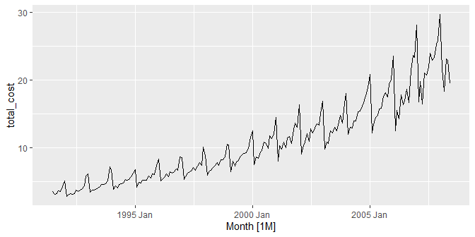
Time plots: Antidiabetic drug sales
a10 %>% autoplot(total_cost)
The sudden drop at the start of each year is caused by a government subsidization scheme that makes it cost-effective for patients to stockpile drugs at the end of the calendar year.

Slide 26
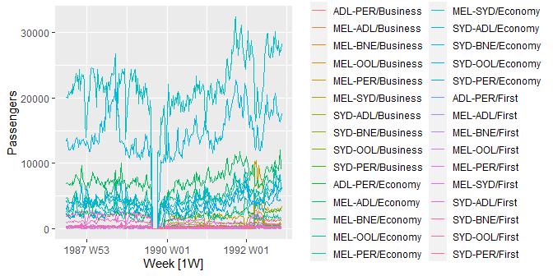
Ansett airlines
ansett %>% autoplot(Passengers)

Slide 27
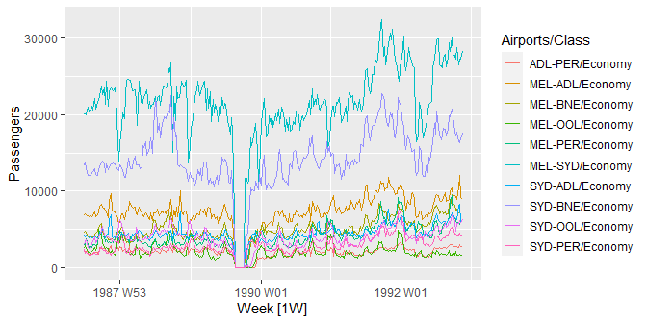
Ansett airlines
ansett %>% filter(Class == "Economy") %>% autoplot(Passengers)
No service due to industry dispute

Slide 28
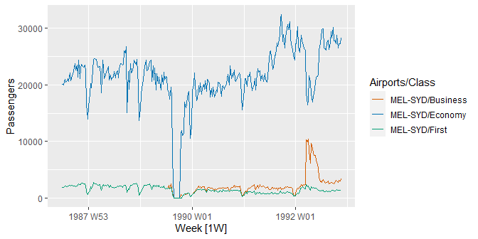
Ansett airlines
ansett %>% filter(Airports == "MEL-SYD") %>% autoplot(Passengers)
Test of converting some economy seats to business class

Slide 29
Time Series Patterns
Trend - A trend exists when there is a long-term increase or decrease in the data. It does not have to be linear. Sometimes we will refer to a trend as “changing direction”, when it might go from an increasing trend to a decreasing trend.
Seasonal - A seasonal pattern occurs when a time series is affected by seasonal factors such as the time of the year or the day of the week. Seasonality is always of a fixed and known frequency.
Cyclic (autocorrelated) - A cycle occurs when the data exhibit rises and falls that are not of a fixed frequency. Duration usually of at least 2 years.
29

Slide 30
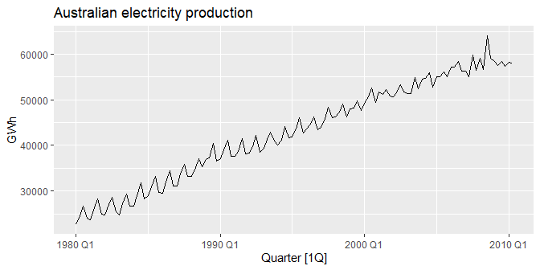
Time series patterns
aus_production %>% filter(year(Quarter) >= 1980) %>% autoplot(Electricity) + labs(y = "GWh", title = "Australian electricity production")

Slide 31
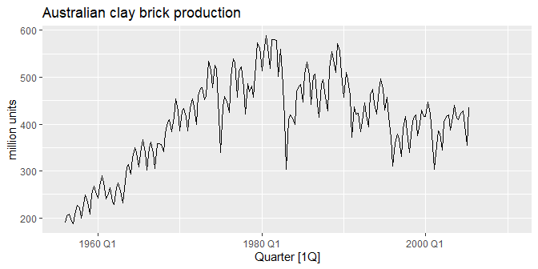
Time series patterns
aus_production %>% autoplot(Bricks) + labs(y = "million units", title = "Australian clay brick production")

Slide 32
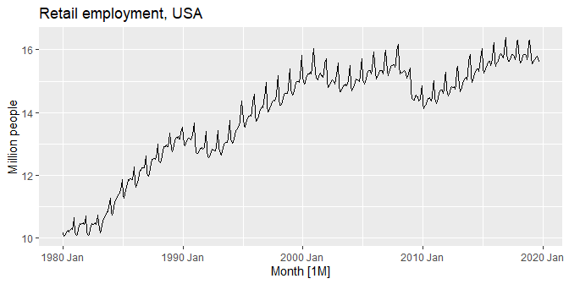
Time series patterns
us_employment %>% filter(Title == "Retail Trade", year(Month) >= 1980) %>% autoplot(Employed / 1e3) + labs(y = "Million people", title = "Retail employment, USA")

Slide 33
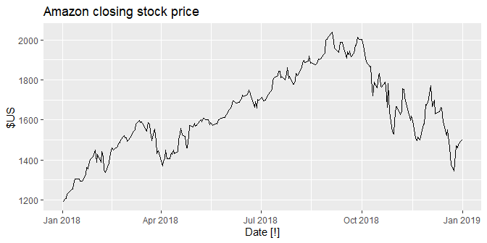
Time series patterns
gafa_stock %>% filter(Symbol == "AMZN", year(Date) >= 2018) %>% autoplot(Close) + labs(y = "$US", title = "Amazon closing stock price")

Slide 34
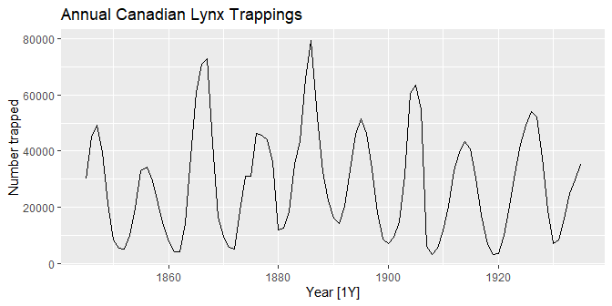
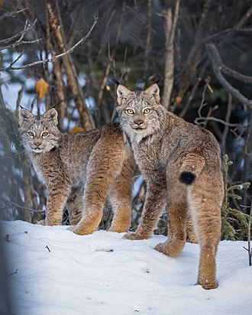
Time series patterns
pelt %>% autoplot(Lynx) + labs(y="Number trapped", title = "Annual Canadian Lynx Trappings")

Slide 35
Time series components
Differences between seasonal and cyclic patterns:
seasonal pattern constant length; cyclic pattern variable length
average length of cycle longer than length of seasonal pattern
magnitude of cycle more variable than magnitude of seasonal pattern
The timing of peaks and troughs is predictable with seasonal data, but much less predictable in the long term with cyclic data.

Slide 36
Seasonal and subseries plots

Slide 37
Seasonal plots
Seasonal plots
Data plotted against the individual “seasons” in which the data were observed. (In this case a “season” is a month.)
Something like a time plot except that the data from each season are overlapped.
Enables the underlying seasonal pattern to be seen more clearly, and also allows any substantial departures from the seasonal pattern to be easily identified.
In R: gg_season()
a10 %>% gg_season(total_cost, labels = "both") +
labs(y = "$ million", title = "Seasonal plot: antidiabetic drug sales")
Seasonal plot: antidiabetic drug sales
³⁰ 2008
2007
2007
2006
2006
₂₀ 2005
2005
$ million
2008
2004
2004
2003₂
2003
2001
2002
2000
2001₀
1999₈
₁₀ 1999
1997
1998
1996
19976
19953
19954
1994₂
1993
1992
1991
1991
Jan
Feb
Mar
Apr
May
Jun
Jul
Aug
Sep
Oct
Nov
Dec
41
Month

Slide 38
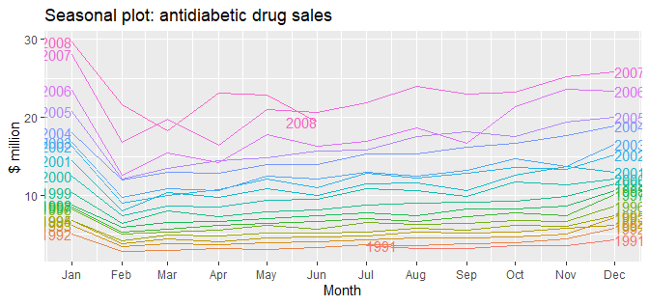
Seasonal plots
Seasonal plot

Slide 39
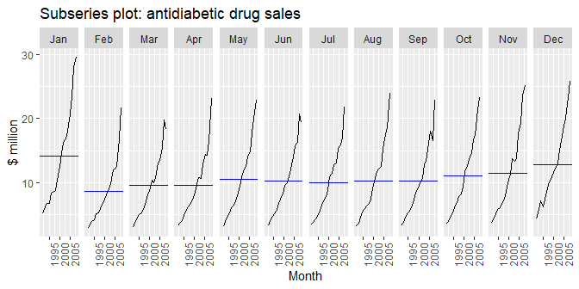
Seasonal subseries plots
a10 %>% gg_subseries(total_cost) + labs(y = "$ million", title = "Subseries plot: antidiabetic drug sales")
Data for each season collected together in time plot as separate time series.
Enables the underlying seasonal pattern to be seen clearly, and changes in seasonality over time to be visualized.
In R: gg_subseries()

Slide 40
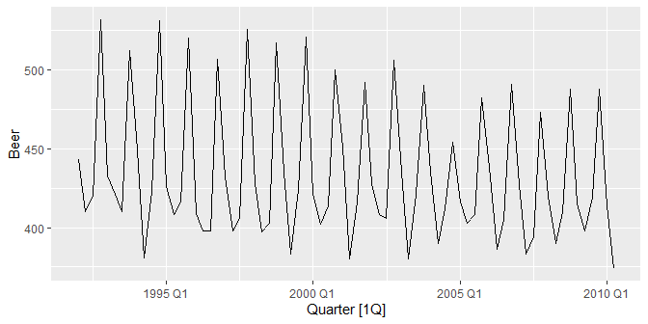
Quarterly Australian Beer Production
beer <- aus_production %>% select(Quarter, Beer) %>% filter(year(Quarter) >= 1992) beer %>% autoplot(Beer)

Slide 41
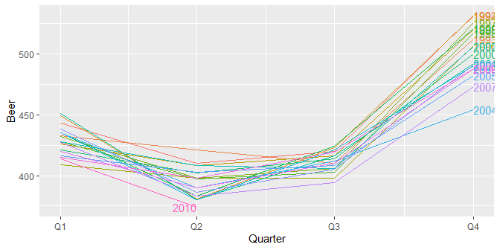
Quarterly Australian Beer Production
beer %>% gg_season(Beer, labels="right")

Slide 42
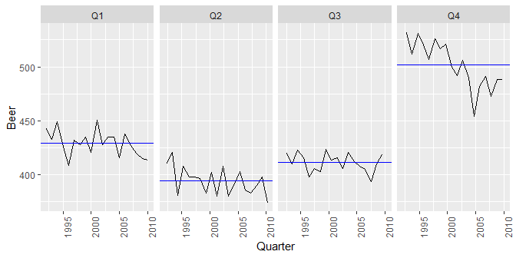
Quarterly Australian Beer Production
beer %>% gg_subseries(Beer)

Slide 43
Multiple seasonal periods
Half-hourly electricity demand for Victoria, Australia
vic_elec
## # A tsibble: 52,608 x 5 [30m] <Australia/Melbourne> ## Time Demand Temperature Date Holiday ## <dttm> <dbl> <dbl> <date> <lgl> ## 1 2012-01-01 00:00:00 4383. 21.4 2012-01-01 TRUE ## 2 2012-01-01 00:30:00 4263. 21.0 2012-01-01 TRUE ## 3 2012-01-01 01:00:00 4049. 20.7 2012-01-01 TRUE ## 4 2012-01-01 01:30:00 3878. 20.6 2012-01-01 TRUE ## 5 2012-01-01 02:00:00 4036. 20.4 2012-01-01 TRUE ## 6 2012-01-01 02:30:00 3866. 20.2 2012-01-01 TRUE ## 7 2012-01-01 03:00:00 3694. 20.1 2012-01-01 TRUE ## 8 2012-01-01 03:30:00 3562. 19.6 2012-01-01 TRUE ## 9 2012-01-01 04:00:00 3433. 19.1 2012-01-01 TRUE ## 10 2012-01-01 04:30:00 3359. 19.0 2012-01-01 TRUE ## # … with 52,598 more rows

Slide 44
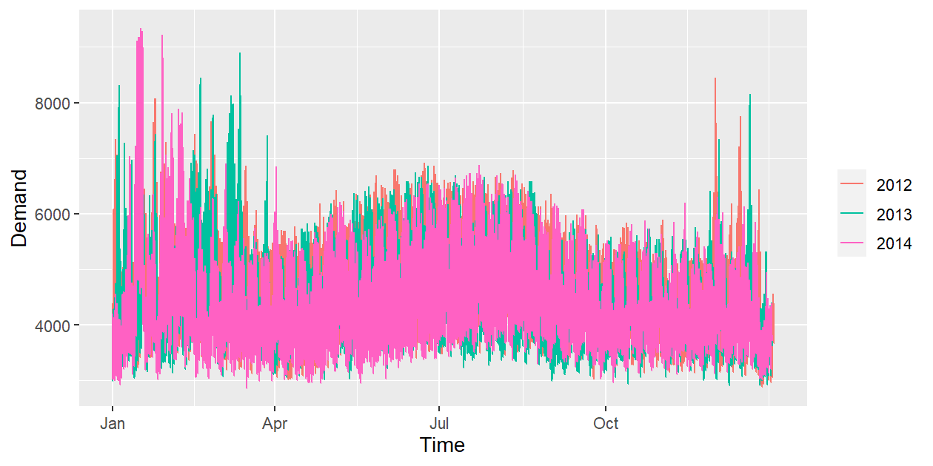
Multiple seasonal periods
vic_elec %>% gg_season(Demand)

Slide 45
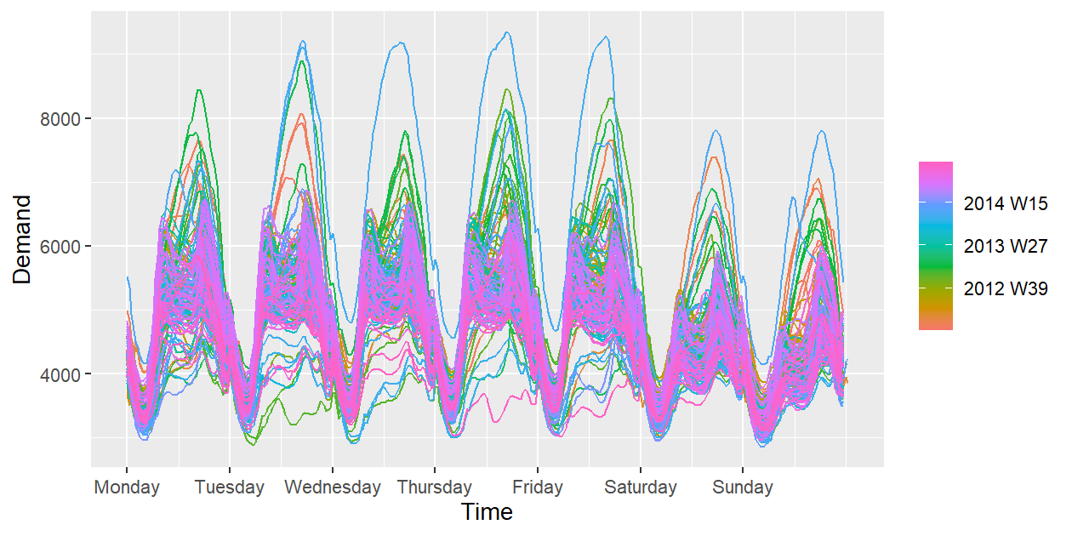
Multiple seasonal periods
vic_elec %>% gg_season(Demand, period = "week")

Slide 46
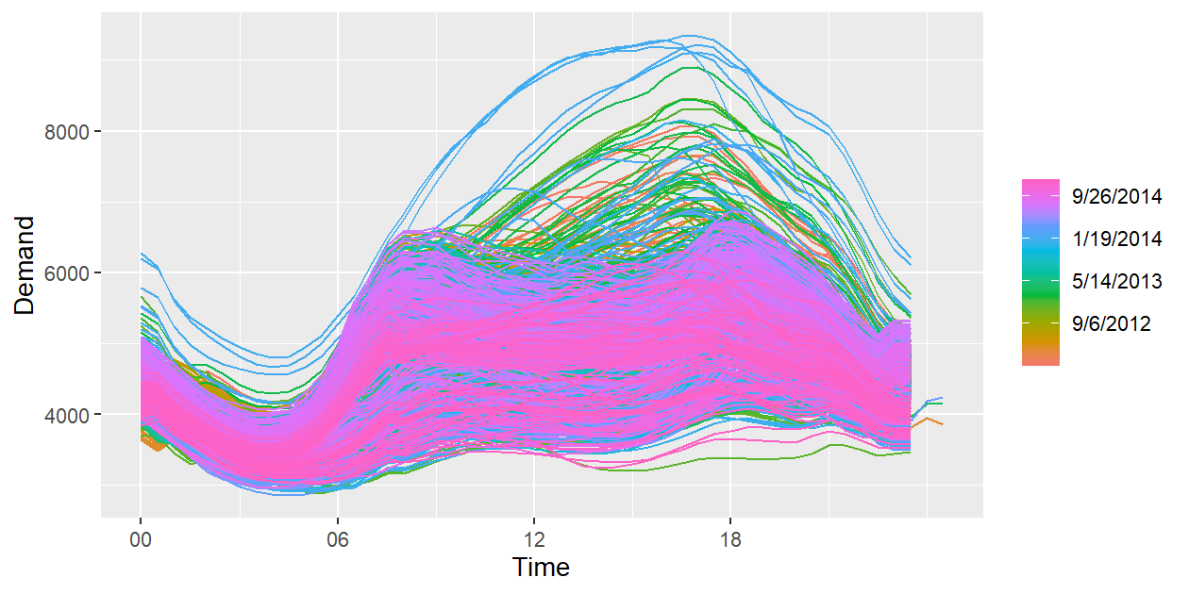
Multiple seasonal periods
vic_elec %>% gg_season(Demand, period = "day")

Slide 47
Australian holidays
holidays <- tourism %>% filter(Purpose == "Holiday") %>% group_by(State) %>% summarise(Trips = sum(Trips))
## # A tsibble: 640 x 3 [1Q] ## # Key: State [8] ## State Quarter Trips ## <chr> <qtr> <dbl> ## 1 ACT 1998 Q1 196. ## 2 ACT 1998 Q2 127. ## 3 ACT 1998 Q3 111. ## 4 ACT 1998 Q4 170. ## 5 ACT 1999 Q1 108. ## 6 ACT 1999 Q2 125. ## 7 ACT 1999 Q3 178. ## 8 ACT 1999 Q4 218. ## 9 ACT 2000 Q1 158. ## 10 ACT 2000 Q2 155. ## # … with 630 more rows

Slide 48
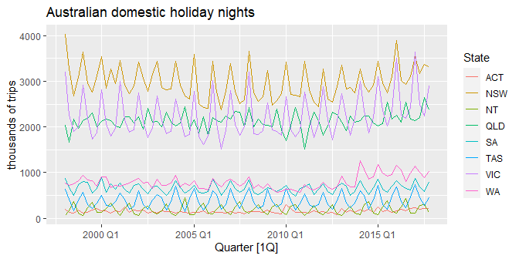
Australian holidays
holidays %>% autoplot(Trips) + labs(y = "thousands of trips", title = "Australian domestic holiday nights")

Slide 49
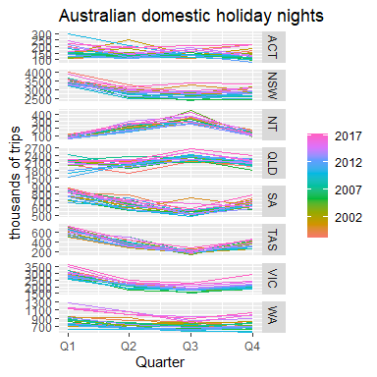
Seasonal plots
holidays %>% gg_season(Trips) + labs(y = "thousands of trips",
title = "Australian domestic holiday nights")

Slide 50
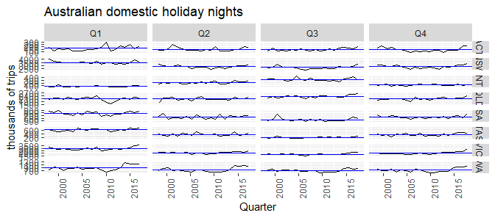
Seasonal subseries plots
holidays %>% gg_subseries(Trips) + labs(y = "thousands of trips", title = "Australian domestic holiday nights")

Slide 51
Lag plots and autocorrelation

Slide 52
Example: Beer production
new_production <- aus_production %>% filter(year(Quarter) >= 1992) new_production
## # A tsibble: 74 x 7 [1Q] ## Quarter Beer Tobacco Bricks Cement Electricity Gas ## <qtr> <dbl> <dbl> <dbl> <dbl> <dbl> <dbl> ## 1 1992 Q1 443 5777 383 1289 38332 117 ## 2 1992 Q2 410 5853 404 1501 39774 151 ## 3 1992 Q3 420 6416 446 1539 42246 175 ## 4 1992 Q4 532 5825 420 1568 38498 129 ## 5 1993 Q1 433 5724 394 1450 39460 116 ## 6 1993 Q2 421 6036 462 1668 41356 149 ## 7 1993 Q3 410 6570 475 1648 42949 163 ## 8 1993 Q4 512 5675 443 1863 40974 138 ## 9 1994 Q1 449 5311 421 1468 40162 127 ## 10 1994 Q2 381 5717 475 1755 41199 159 ## # … with 64 more rows

Slide 53
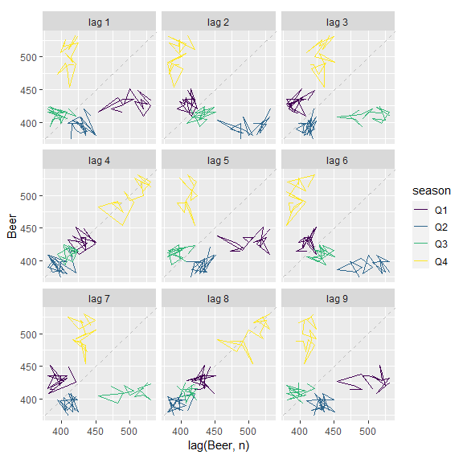
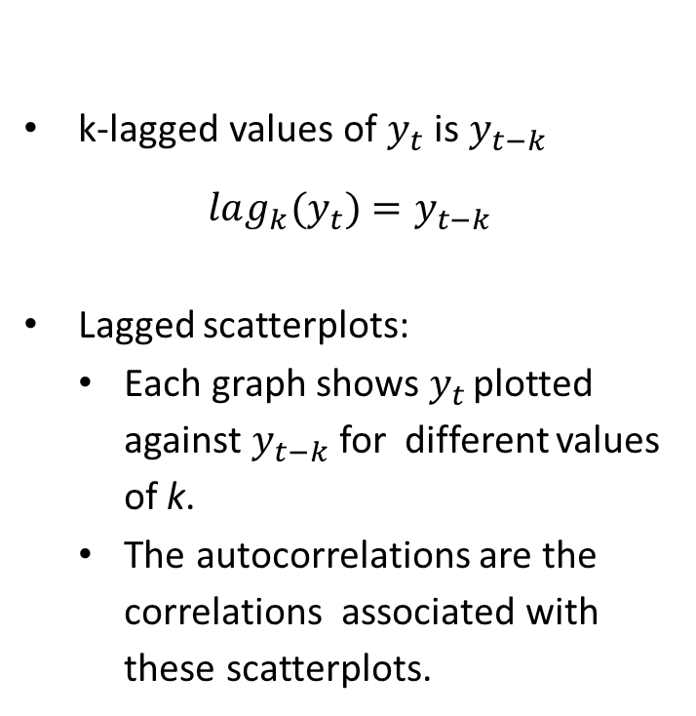
Lagged scatterplots
k-lagged values of $y_{t}$ is $y_{t−k}$
$$lag_{k}(y_{t})=y_{t−k}$$
Lagged scatterplots:
Each graph shows $y_{t}$ plotted against $y_{t−k}$for different values of k.
The autocorrelations are the correlations associated with these scatterplots.
Example: Beer production:
new_production %>% gg_lag(Beer)

Slide 54
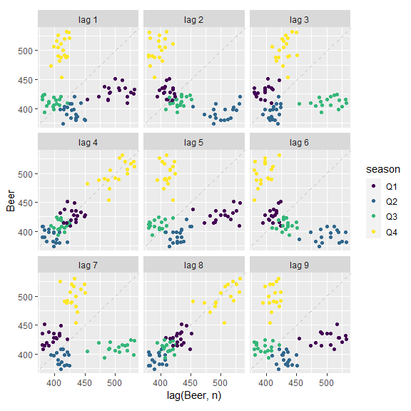
Example: Beer production
new_production %>% gg_lag(Beer, geom='point')

Slide 55
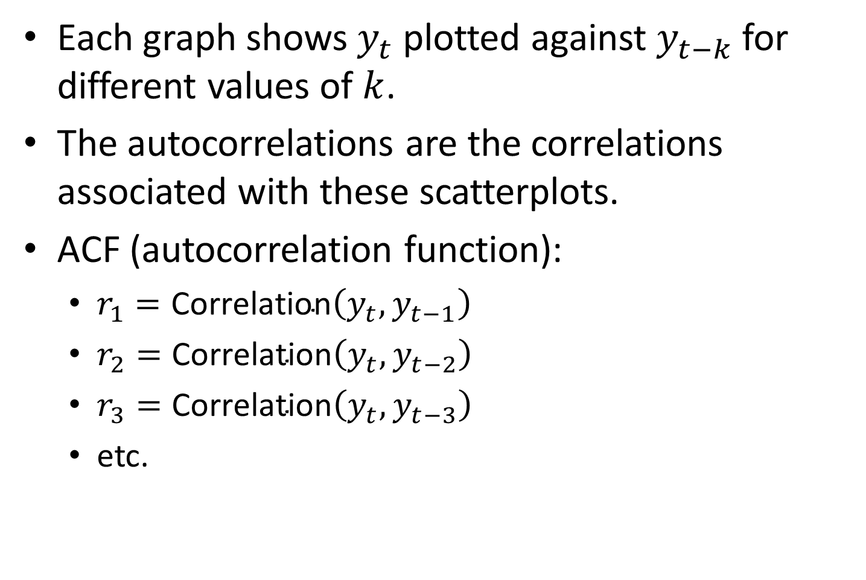
Lagged scatterplots and Autocorrelation
Each graph shows $y_{t}$ plotted against $y_{t−k}$ for different values of $k$.
The autocorrelations are the correlations associated with these scatterplots.
ACF (autocorrelation function):
$r_{1}=\text{Correlation}\left(y_{t},y_{t−1}\right)$
$r_{2}=\text{Correlation}\left(y_{t},y_{t−2}\right)$
$r_{3}=\text{Correlation}\left(y_{t},y_{t−3}\right)$
etc.

Slide 56
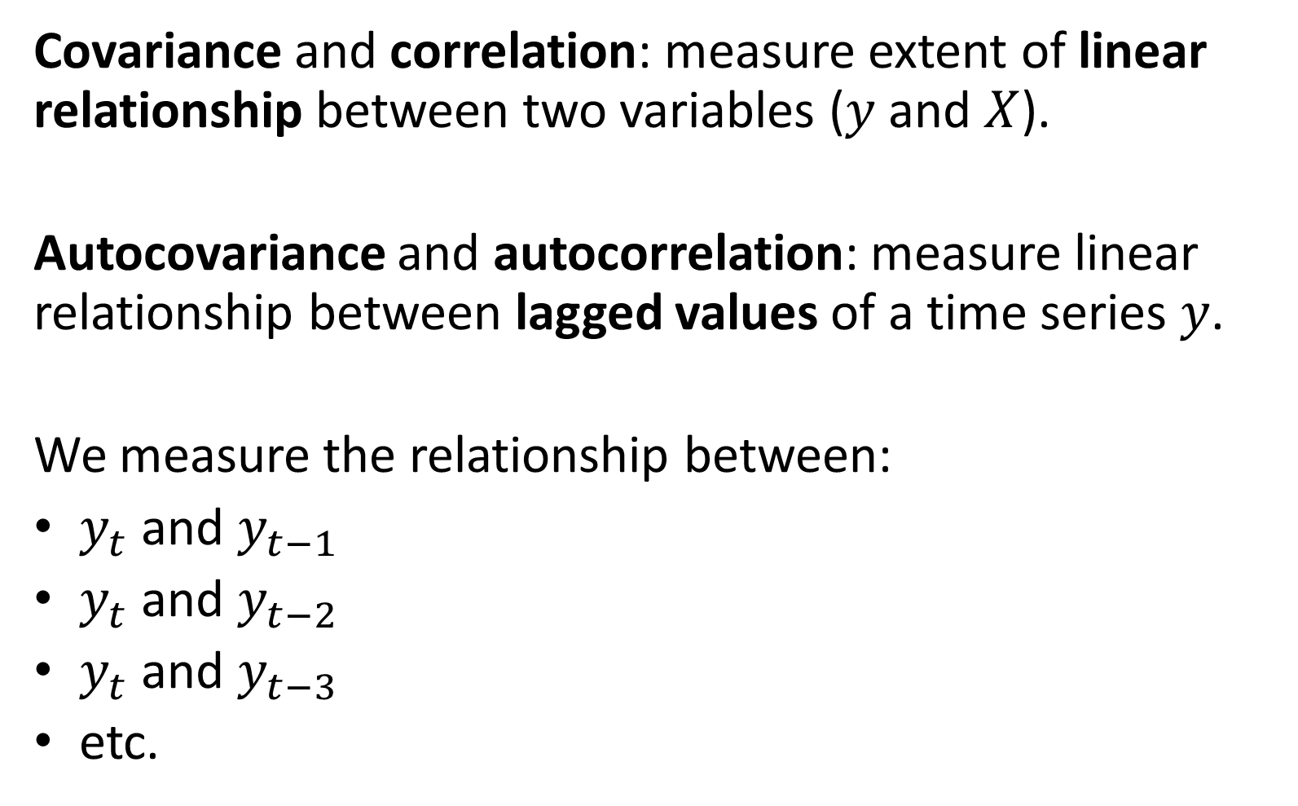
Autocorrelation
Covariance and correlation: measure extent of linear relationship between two variables ($y$ and $X$).
Autocovariance and autocorrelation: measure linear relationship between lagged values of a time series $y$.
We measure the relationship between:
$y_{t}$ and $y_{t−1}$
$y_{t}$ and $y_{t−2}$
$y_{t}$ and $y_{t−3}$
etc.

Slide 57
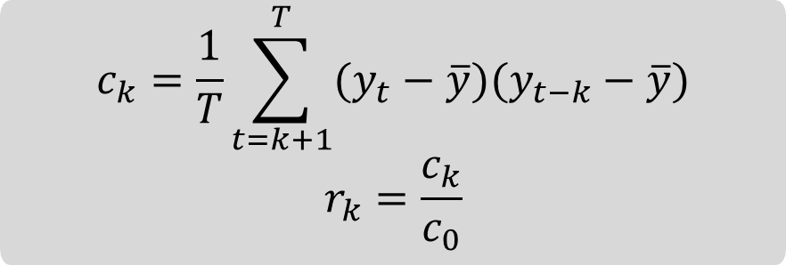
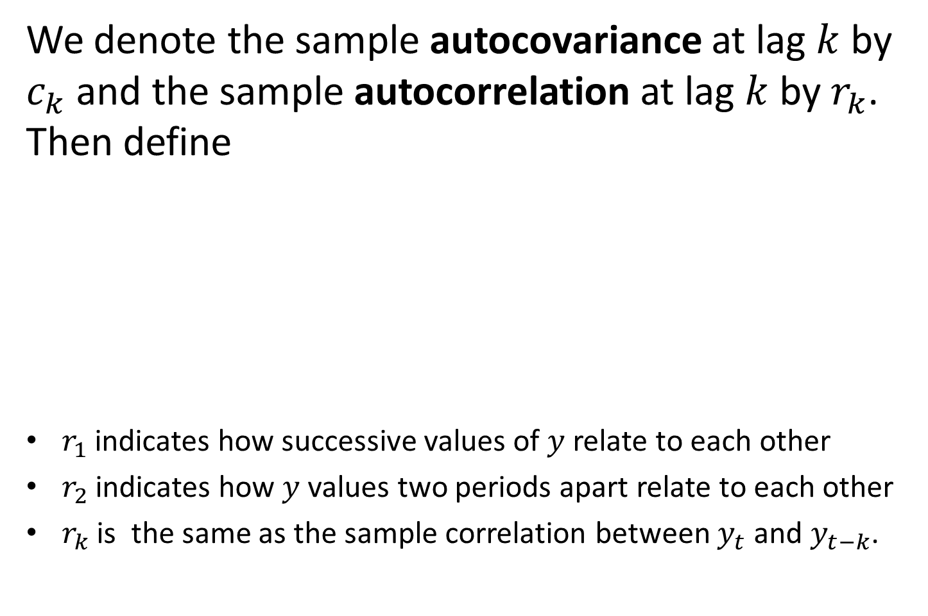
Autocorrelation
We denote the sample autocovariance at lag $k$ by $c_{k}$ and the sample autocorrelation at lag $k$ by $r_{k}$. Then define
$r_{1}$ indicates how successive values of $y$ relate to each other
$r_{2}$ indicates how $y$ values two periods apart relate to each other
$r_{k}$ is the same as the sample correlation between $y_{t}$ and $y_{t−k}$.
$$c_{k}=\frac{1}{T}\sum_{t=k+1}^{T}{(y_{t}−\overline{y})(y_{t−k}−\overline{y})}$$
$$r_{k}=\frac{c_{k}}{c_{0}}$$

Slide 58
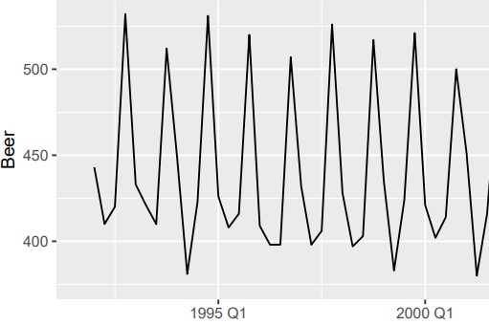
Autocorrelation
Results for first 9 lags for beer data:
new_production %>%
ACF(Beer, lag_max = 9)
## # A tsibble: 9 x 2 [1Q] ## lag acf ## <lag> <dbl> ## 1 1Q -0.102 ## 2 2Q -0.657 ## 3 3Q -0.0603 ## 4 4Q 0.869 ## 5 5Q -0.0892 ## 6 6Q -0.635 ## 7 7Q -0.0542 ## 8 8Q 0.832 ## 9 9Q -0.108

Slide 59
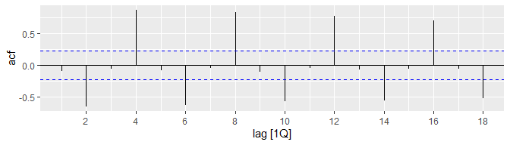
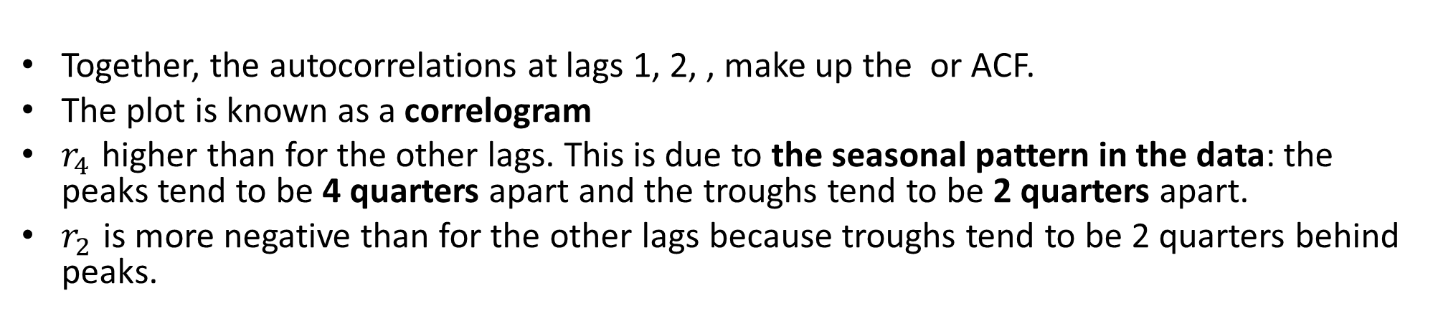
Autocorrelation
new_production %>% ACF(Beer) %>% autoplot()
Together, the autocorrelations at lags 1, 2, , make up the or ACF.
The plot is known as a correlogram
$r_{4}$ higher than for the other lags. This is due to the seasonal pattern in the data: the peaks tend to be 4 quarters apart and the troughs tend to be 2 quarters apart.
$r_{2}$ is more negative than for the other lags because troughs tend to be 2 quarters behind peaks.

Slide 60
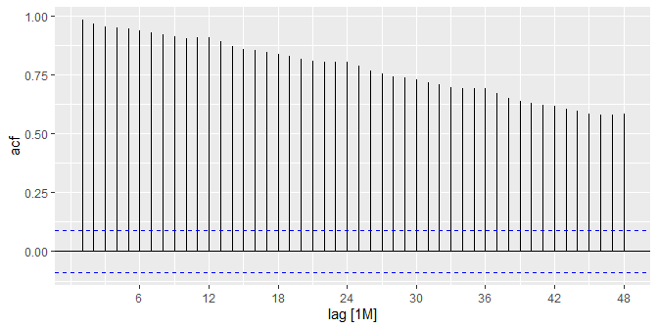
Trend and seasonality in ACF plots
When data have a trend, the autocorrelations for small lags tend to be large and positive.
When data are seasonal, the autocorrelations will be larger at the seasonal lags (i.e., at multiples of the seasonal frequency)
When data are trended and seasonal, you see a combination of these effects.

Slide 61
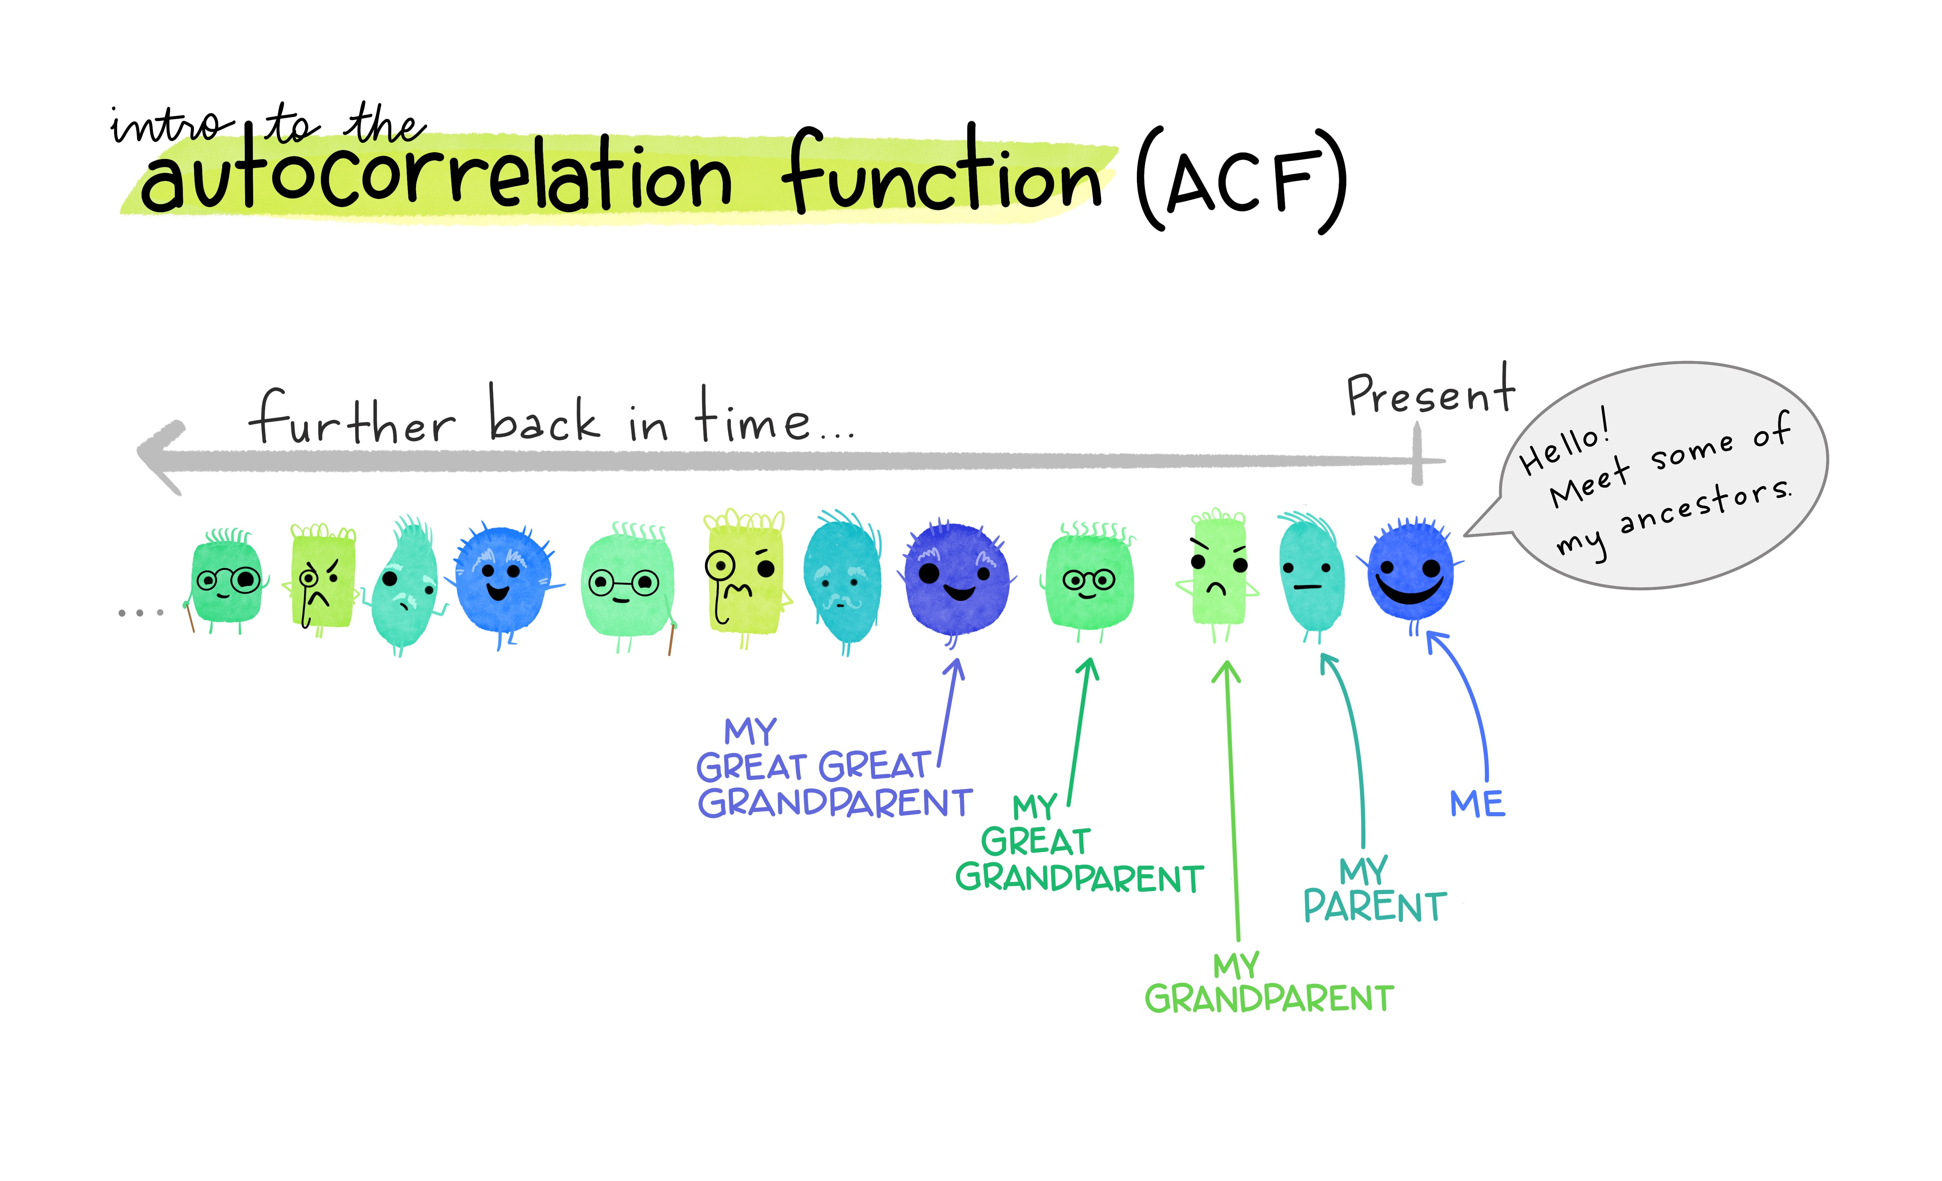
Autocorrelation functions
Autocorrelation functions
67
Artwork by @allison_horst

Slide 62
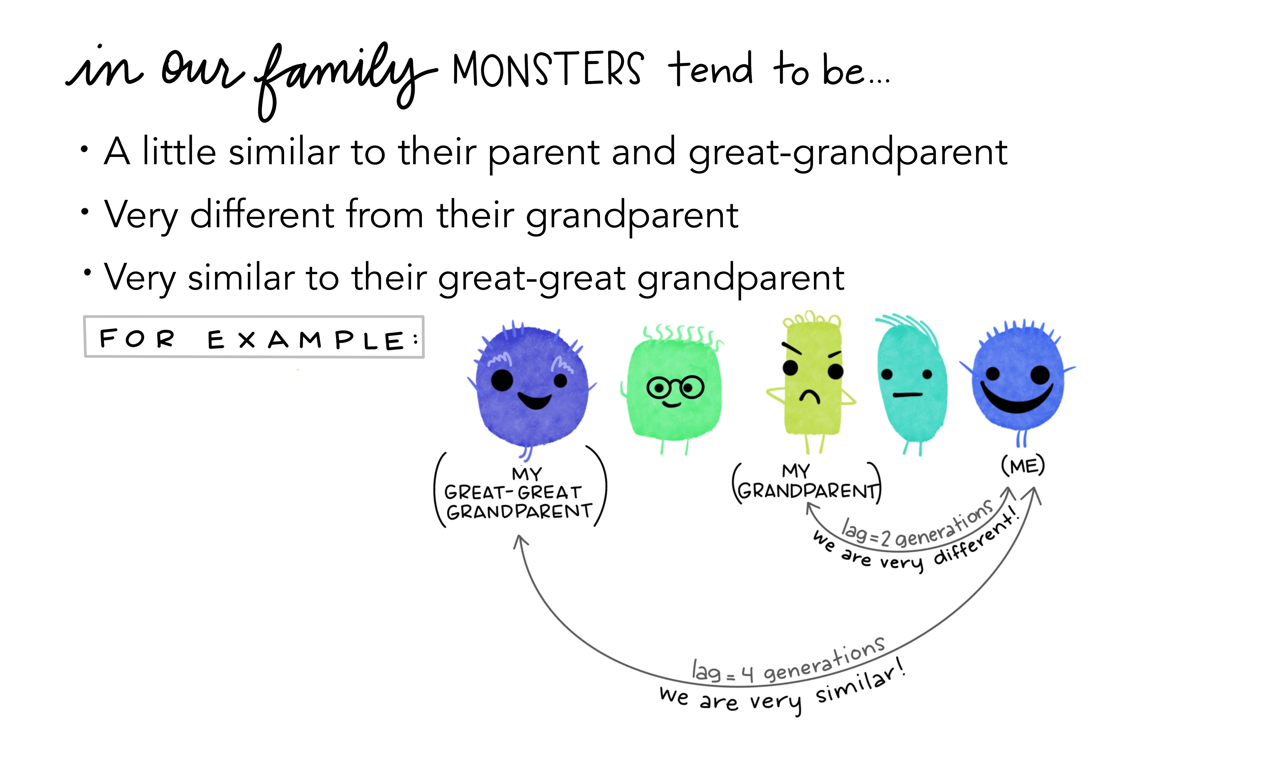
Autocorrelation functions
Autocorrelation functions
67
Artwork by @allison_horst

Slide 63
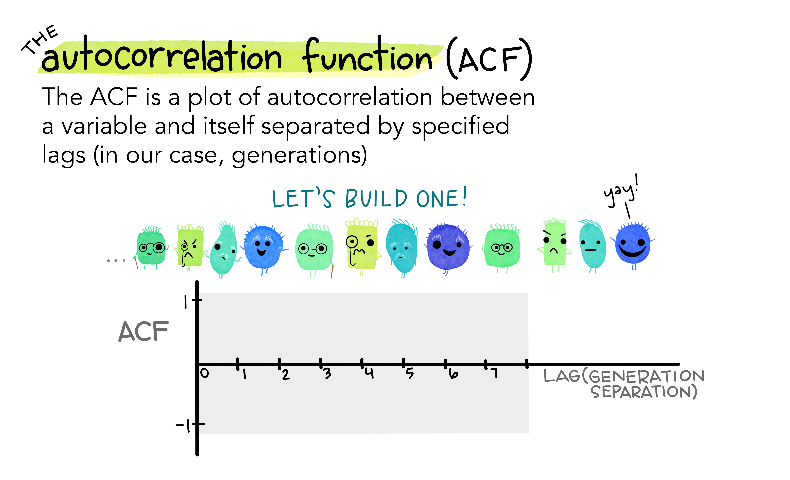
Autocorrelation functions
Autocorrelation functions
67
Artwork by @allison_horst

Slide 64
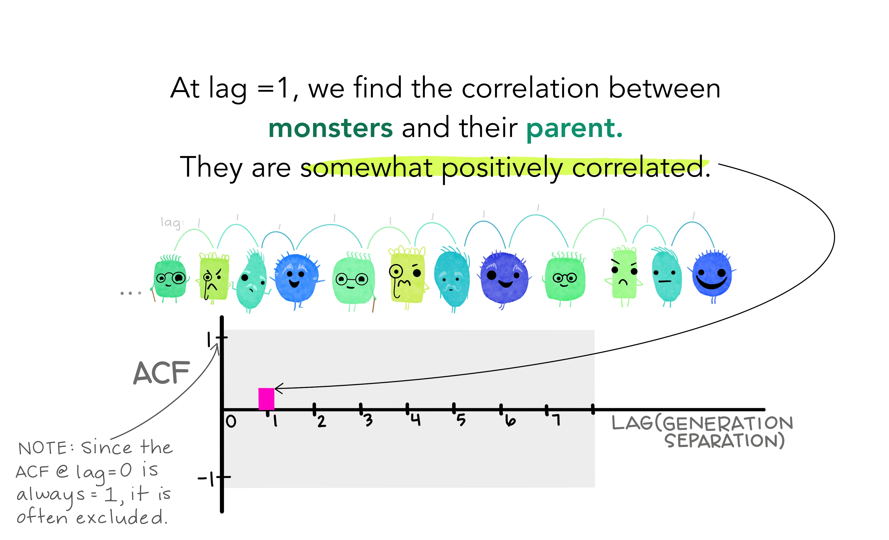
Autocorrelation functions
Autocorrelation functions
67
Artwork by @allison_horst

Slide 65
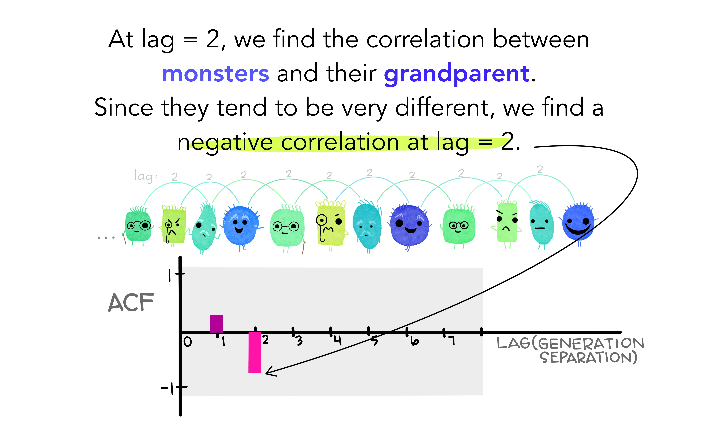
Autocorrelation functions
Autocorrelation functions
67
Artwork by @allison_horst

Slide 66
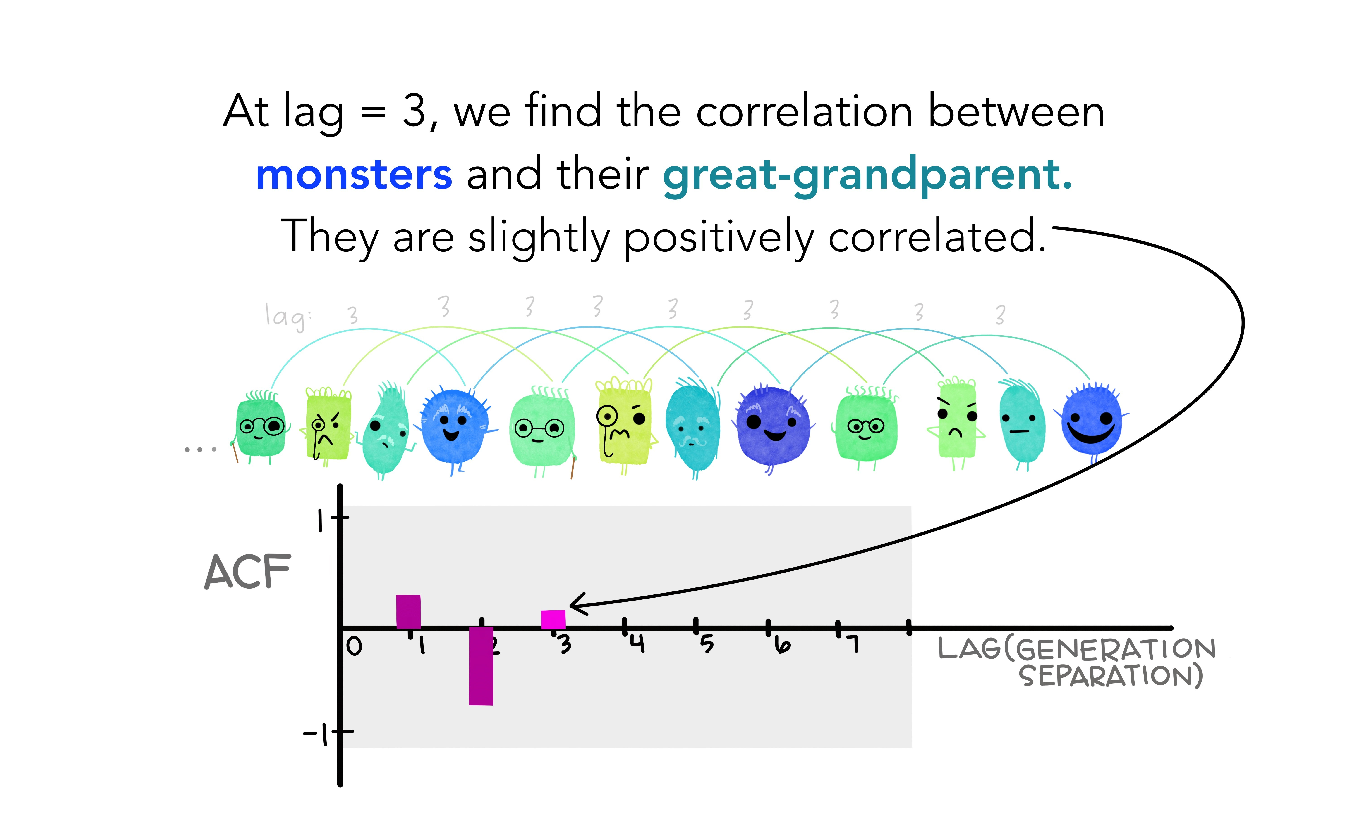
Autocorrelation functions
Autocorrelation functions
67
Artwork by @allison_horst

Slide 67
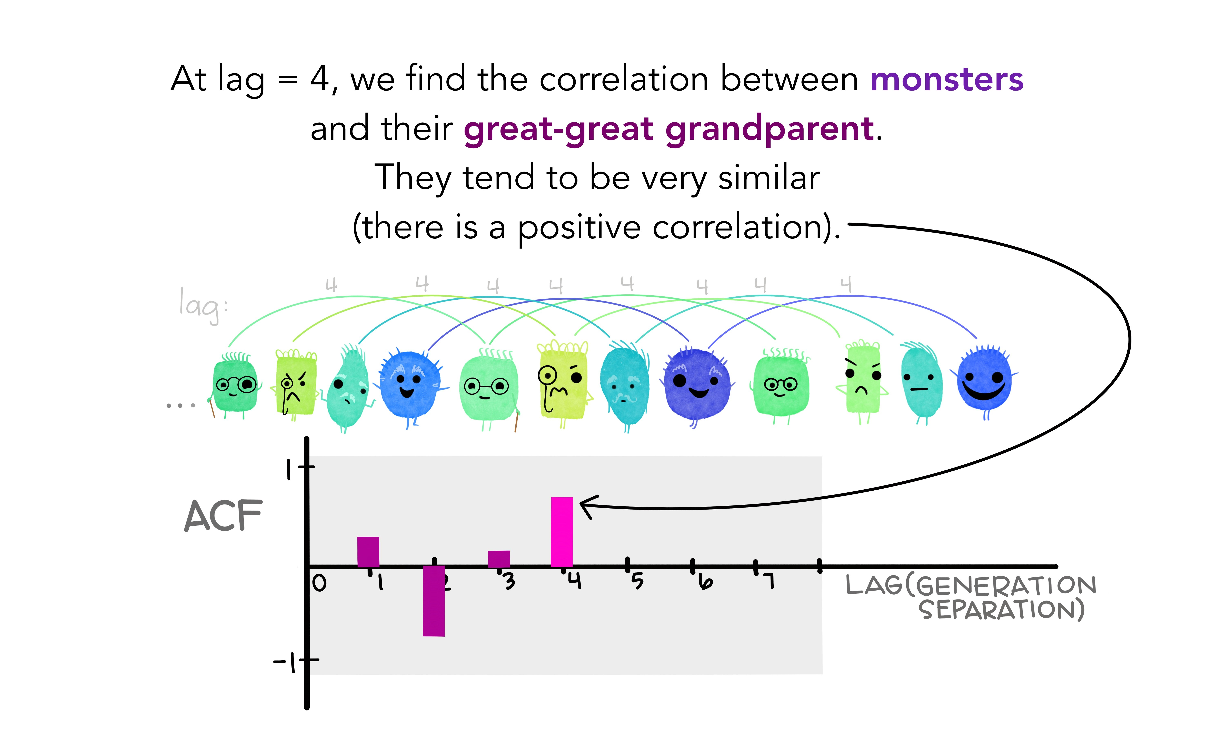
Autocorrelation functions
Autocorrelation functions
67
Artwork by @allison_horst

Slide 68
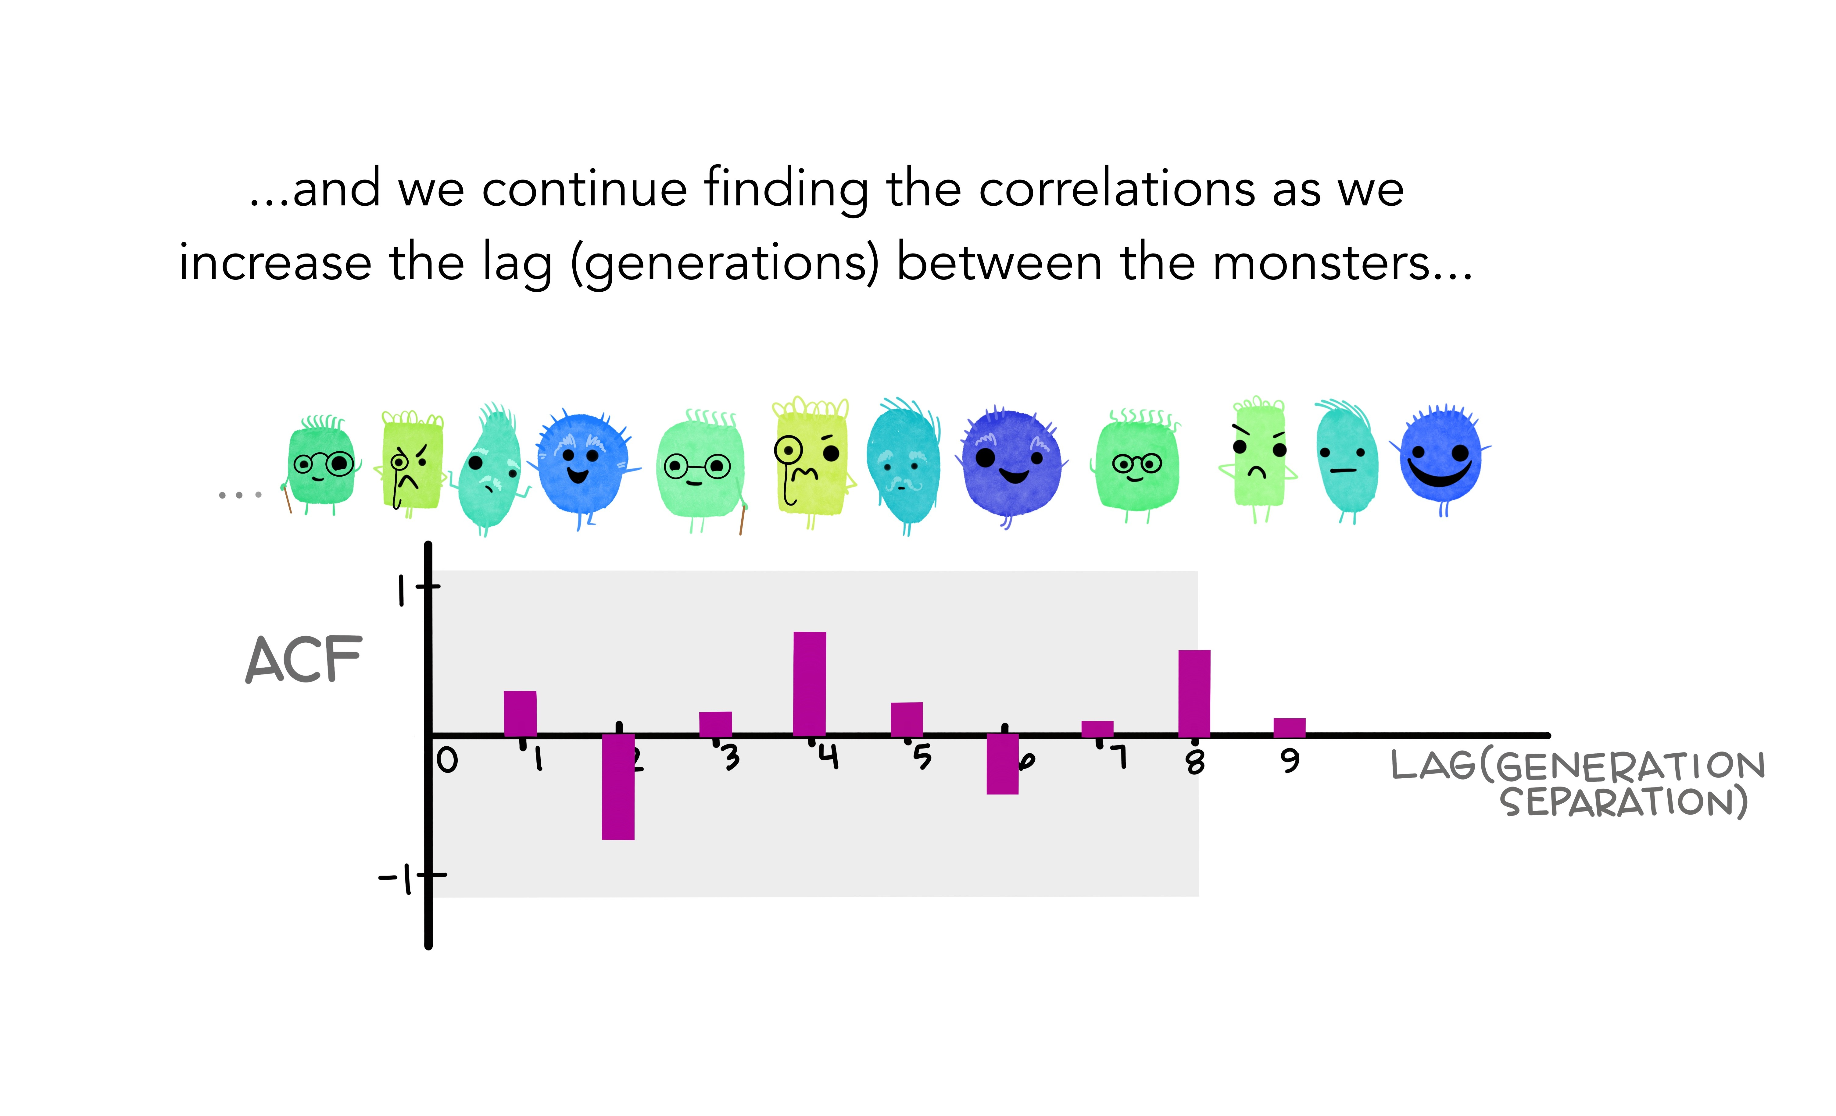
Autocorrelation functions
Autocorrelation functions
67
Artwork by @allison_horst

Slide 69
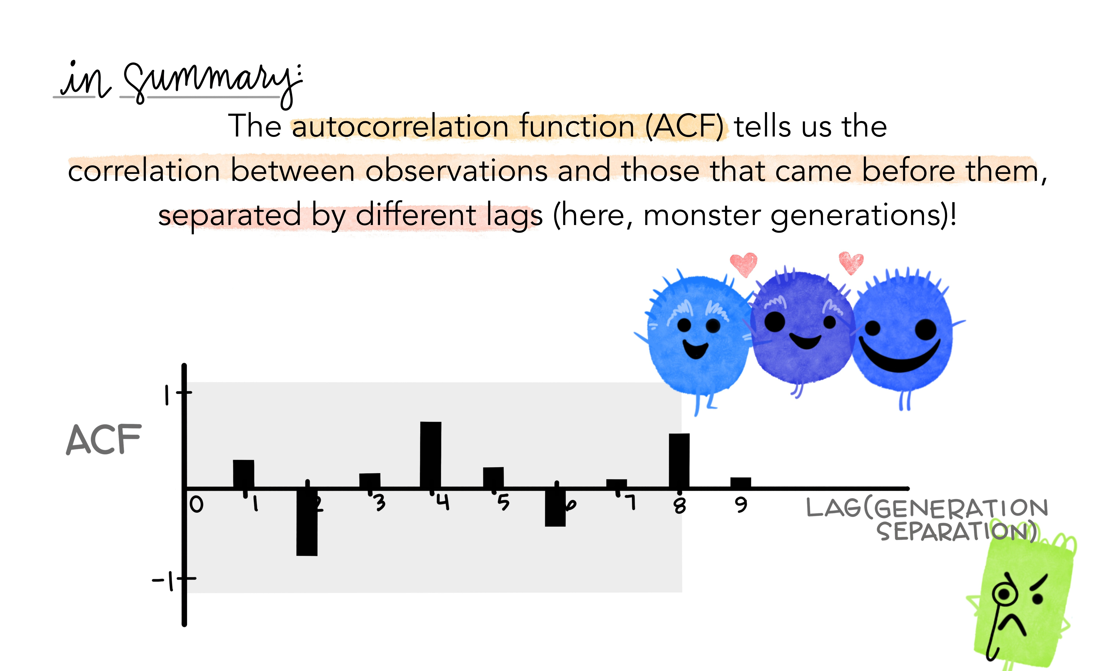
Autocorrelation functions
Autocorrelation functions
67
Artwork by @allison_horst

Slide 70
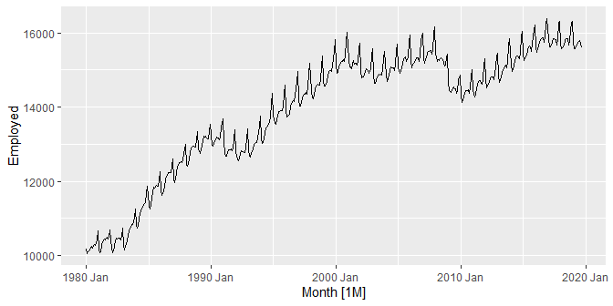
US retail trade employment
retail <- us_employment %>% filter(Title == "Retail Trade", year(Month) >= 1980) retail %>% autoplot(Employed)

Slide 71
US retail trade employment
retail %>% ACF(Employed, lag_max = 48) %>% autoplot()

Slide 72
Google stock price
google_2015 <- gafa_stock %>% filter(Symbol == "GOOG", year(Date) == 2015) %>% select(Date, Close) google_2015
## # A tsibble: 252 x 2 [!] ## Date Close ## <date> <dbl> ## 1 2015-01-02 522. ## 2 2015-01-05 511. ## 3 2015-01-06 499. ## 4 2015-01-07 498. ## 5 2015-01-08 500. ## 6 2015-01-09 493. ## 7 2015-01-12 490. ## 8 2015-01-13 493. ## 9 2015-01-14 498. ## 10 2015-01-15 499. ## # … with 242 more rows

Slide 73
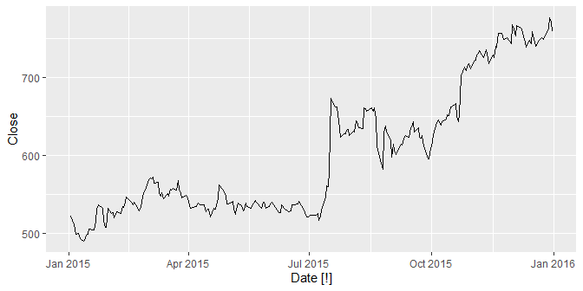
Google stock price
google_2015 %>% autoplot(Close)

Slide 74
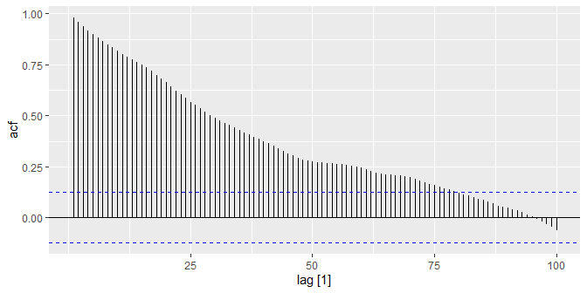
Google stock price
google_2015 %>% ACF(Close, lag_max=100)
## # A tsibble: 100 x 2 [1] ## lag acf ## <lag> <dbl> ## 1 1 0.982 ## 2 2 0.959 ## 3 3 0.937 ## 4 4 0.918 ## 5 5 0.901 ## 6 6 0.883 ## 7 7 0.865 ## 8 8 0.849 ## 9 9 0.834 ## 10 10 0.818 ## # … with 90 more rows
google_2015 %>% ACF(Close, lag_max = 100) %>% autoplot()

Slide 75

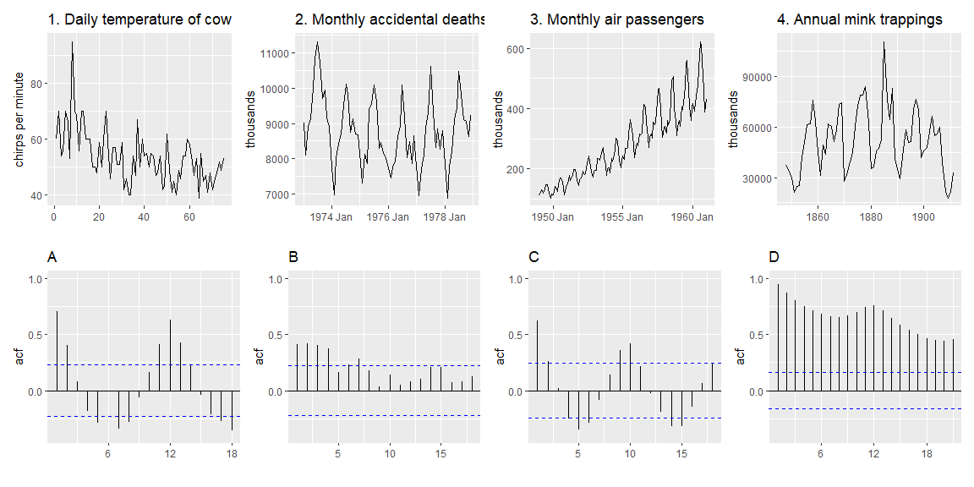
Which is which?

Slide 76
White noise

Slide 77
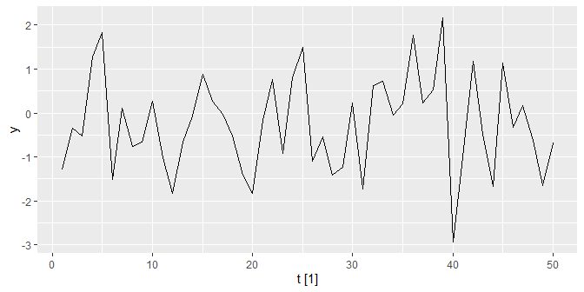
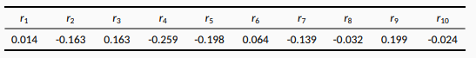

White noise
Time series that show no autocorrelation are called white noise.
White−noise data is uncorrelated across time with zero mean and constant variance (Technical0ly, we require1i0ndependence20as well)
set.seed(30) wn <- tsibble(t = 1:50, y = rnorm(50), index = t) wn %>% autoplot(y)
y %>%
ACF(wn) %>%
autoplot() + labs(title = "White noise")
Sample autocorrelations for white noise series.
Expect each autocorrelation to be close to zero.
Blue lines show 95% critical values.

Slide 78

Sampling distribution of autocorrelations
Sampling distribution of $r_{k}$ for white noise data is asymptotically N(0,$1/T$), where T is the length of the time series.
95% of all $r_{k}$ for white noise must lie within $±1.96/\sqrt{T}$.
If this is not the case, the series is probably not WN.
Common to plot lines at $±1.96/\sqrt{T}$ when plotting ACF. These are the critical values.

Slide 79

Example: Pigs slaughtered
pigs <- aus_livestock %>% filter(State == "Victoria", Animal == "Pigs", year(Month) >= 2014) pigs %>% autoplot(Count/1e3) + labs(y = "Thousands", title = "Number of pigs slaughtered in Victoria")

Slide 80

Example: Pigs slaughtered
pigs %>% ACF(Count) %>% autoplot()

Slide 81
Example: Pigs slaughtered
Monthly total number of pigs slaughtered in the state of Victoria, Australia, from January 2014 through December 2018 (Source: Australian Bureau of Statistics.)
Difficult to detect pattern in time plot.
ACF shows significant autocorrelation for lag 2 and 12.
Indicate some slight seasonality.
These show the series is not a white noise series.

